Slide 1



Modeling and Simulation
Faculty of Computers and Information
Mansoura University
Prof. Dr. Hazem El-Bakry
Information Systems Dept.
elbakry@mans.edu.eg

Slide 2

Modeling and Data Structure

Slide 3
Modeling
Modeling can be defined as describing things in the world in terms of their structure and behavior.
  F=ma (Force=mass * acceleration) is part of a model of the world that describes what happens when one thing hits another.
  Maps model physical spaces and their physical relationships

Slide 4
On a computer
we can execute these models: Make them work, plug values into equations, move things in space, see what happens.
  That’s simulation: Executing a model

Slide 5
What’s a data structure?
Data Structure is a systematic way to organize data in order to use it efficiently. It is a specialized format for organizing and storing data. General data structure types include the array, the file, the record, the table, the tree, and so on.
Any data structure is designed to organize data to suit a specific purpose so that it can be accessed and worked with in appropriate ways.
In computer programming, a data structure may be selected or designed to store data for the purpose of working on it with various algorithms.

Slide 6
What’s a data structure?
In computer science, a data structure is a data organization, management and storage format that enables efficient access and modification. More precisely, a data structure is a collection of data values, the relationships among them, and the functions or operations that can be applied to the data.

Slide 7
Data structures definition in general
In general it is a way of organizing information.
Different physical structures organize space differently.
  Skyscrapers vs. ranch homes.
Data structures organize the information we use in our programs in different ways.

Slide 8
Data structures have different properties
Arrays and tables keep things organized right next to one another.
  Makes it easy to find something in the array or table
  But if you want to insert something new, you have to move everything over.
Linked lists and trees keep track of relationships with links (or edges)
  Easier to insert new things

Slide 9
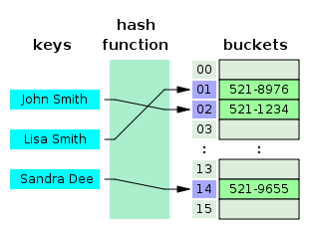
A data structure known as a hash table.

Slide 10
Abstract Data Types (ADT)
Data structures can implement one or more particular abstract data types (ADT), which specify the operations that can be performed on a data structure and the computational complexity of those operations. In comparison, a data structure is a concrete implementation of the space provided by an ADT.

Slide 11
kinds of data structures
Different kinds of data structures are suited to different kinds of applications, and some are highly specialized to specific tasks. For example, relational databases commonly use B-tree indexes for data retrieval, while compiler implementations usually use hash tables to look up identifiers.

Slide 12
kinds of data structures
Data structures provide a means to manage large amounts of data efficiently for uses such as large databases and internet indexing services. Usually, efficient data structures are key to designing efficient algorithms.
Some formal design methods and programming languages emphasize data structures, rather than algorithms, as the key organizing factor in software design.
Data structures can be used to organize the storage and retrieval of information stored in both main memory and secondary memory

Slide 13
Data
Data are values or set of values. Data Item − Data item refers to single unit of values.
Data (pl.):
    Raw facts.
    Distinct pieces of information usually formatted in a special way.
Note: the term ‘raw data’ refers to unprocessed data.

Slide 14
Information
A collection of facts organized in such a way that they have additional value beyond the value of the facts themselves.

Slide 15
Knowledge base
The collection of data, rules, procedures, and relationships that must be followed to achieve value or the proper outcome.

Slide 16
Process
    (n) An executing program. The term is used loosely as a synonym of task.
    (v) To perform some useful operations on data.

Slide 17
Data ‘Discussion’
Distinct pieces of information usually formatted in a special way. All software is divided into two general categories: data and programs. Programs are collections of instructions for manipulating data.

Slide 18
Data ‘Discussion’
Data can exist in a variety of forms -- as numbers or text on pieces of paper, as bits and bytes stored in electronic memory, or as facts stored in a person's mind.
Strictly speaking, data is the plural of datum, a single piece of information. In practice, however, people use data as both the singular and plural form of the word.

Slide 19
Data ‘Discussion’
The term data is often used to distinguish binary machine-readable information from textual human-readable information. For example, some applications make a distinction between data files (files that contain binary data) and text files (files that contain ASCII data).

Slide 20
Types of Data
Data | Represented by
Alphanumeric data | Numbers, letters, and other characters
Image data | Graphic images or pictures
Audio data | Sound, noise, tones
Video data | Moving images or pictures

Slide 21
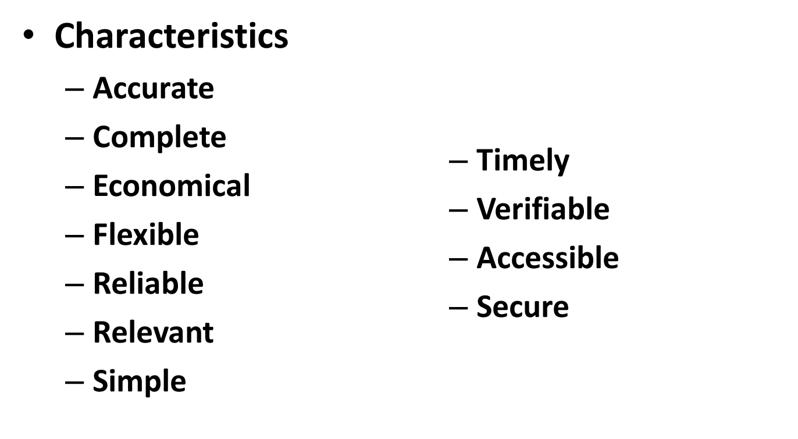
Characteristics of Valuable Data

Slide 22
Group Items
Data items that are divided into sub items are called as Group Items.

Slide 23
Elementary Items
Data items that cannot be divided are called as Elementary Items.

Slide 24
Attribute and Entity
An entity is that which contains certain attributes or properties, which may be assigned values.

Slide 25
Entity Set
Entities of similar attributes form an entity set.
Field − Field is a single elementary unit of information representing an attribute of an entity.

Slide 26
File
File is a collection of records of the entities in a given entity set.

Slide 27
Simple variables – are primitive types
primitive data types:
  An array
  A linked list
  random access
  A record
  A union
  tagged union (variant)
  Objects

Slide 28
An array
is a number of elements in a specific order, typically all of the same type (depending on the language, individual elements may either all be forced to be the same type, or may be of almost any type).
Elements are accessed using an integer index to specify which element is required.
Typical implementations allocate contiguous memory words for the elements of arrays (but this is not always a necessity).
Arrays may be fixed-length or resizable.

Slide 29
linked list
A linked list (also just called list) is a linear collection of data elements of any type, called nodes, where each node has itself a value, and points to the next node in the linked list.
The principal advantage of a linked list over an array, is that values can always be efficiently inserted and removed without relocating the rest of the list.
Certain other operations, such as random access to a certain element, are however slower on lists than on arrays.

Slide 30
record
A record (also called tuple or struct) is an aggregate data structure. It is a collection of field values of a given entity. A record is a value that contains other values, typically in fixed number and sequence and typically indexed by names. The elements of records are usually called fields or members.

Slide 31
A union
is a data structure that specifies which of a number of permitted primitive types may be stored in its instances, e.g.
float or long integer. Contrast with a record, which could be defined to contain a float and an integer; whereas in a union, there is only one value at a time.
Enough space is allocated to contain the widest member datatype.

Slide 32
A tagged union
also called variant, variant record, discriminated union, or disjoint union) contains an additional field indicating its current type, for enhanced type safety.

Slide 33
Objects
are collection of data items of various types. An object is a data structure that contains data fields, like a record, as well as various methods which operate on the contents of the record.
In the context of object-oriented programming, records are known as plain old data structures to distinguish them from objects.

Slide 34
Implementation
Implementation provides the internal representation of a data structure. Implementation also provides the definition of the algorithms used in the operations of the data structure.

Slide 35
Characteristics of a Data Structure
1. Correctness: Data structure implementation should implement its interface correctly.
2. Time Complexity: Running time or the execution time of operations of data structure must be as small as possible.
3. Space Complexity: Memory usage of a data structure operation should be as little as possible.

Slide 36
Need for Data Structure
As applications are getting complex and data rich, there are three common problems that applications face now-a-days.
1. Data Search:- Consider an inventory of 1 million(106) items of a store. If the application is to search an item, it has to search an item in 1 million(106) items every time slowing down the search. As data grows, search will become slower.

Slide 37
Need for Data Structure
Processor Speed :- Processor speed although being very high, falls limited if the data grows to billion records.
3. Multiple Requests :- As thousands of users can search data simultaneously on a web server, even the fast server fails while searching the data.

Slide 38
To solve this problems
data structures come to rescue. Data can be organized in a data structure in such a way that all items may not be required to be searched, and the required data can be searched almost instantly.

Slide 39
Execution Time Cases
There are three cases which are usually used to compare various data structure's execution time in a relative manner.
  Worst Case
  Average Case
  Best Case

Slide 40
Worst Case
This is the scenario where a particular data structure operation takes maximum time it can take. If an operation's worst case time is ƒ(n) then this operation will not take more than ƒ(n) time, where ƒ(n) represents function of n.

Slide 41
Average Case
This is the scenario depicting the average execution time of an operation of a data structure. If an operation takes ƒ(n) time in execution, then m operations will take mƒ(n) time.

Slide 42
Best Case
This is the scenario depicting the least possible execution time of an operation of a data structure. If an operation takes ƒ(n) time in execution, then the actual operation may take time as the random number which would be maximum as ƒ(n).

Slide 43
ROLE OF DATA-STRUCTURES IN COMPUTATION
Makes Computations Faster:
• Faster is better. (Another way to make computations faster is to use parallel or distributed computation.)
Computation = Sequence of Computation Steps

Slide 44
Three Basic Computation Steps:
(1) Locate/Access data-values (inputs to a step)
(2) Compute a value (output of a step)
(3) Store the new value

Slide 45
Program: Algorithm + Data Structure + Execution
• Algorithm − The basic method; it determines the data-items computed. − Also, the order in which those data-items are computed (and hence the order of read/write data-access operations).

Slide 46
Algorithms
Algorithms are designed to solve problems.
A problem can have multiple solutions.
How do we determine which solution is the most efficient?

Slide 47
Measuring the execution Time
Construct a program for a given solution.
Execute the program.
Time it using a “wall clock”.
Dependent on:
  amount of data
  type of hardware and time of day
  programming language and compiler

Slide 48
Data structures
Data structures − Supports efficient read/write of data-items used/computed.

Slide 49
Total Time
Time to access/store data + Time to compute data.

Slide 50
Efficient Algorithm
Efficient Algorithm = Good method + Good data structures + Good Execution

Slide 51
Questions:
• What is an efficient program?
• What determines the speed of an Algorithm?
• A program must also solve a "problem". Which of the
three parts algorithm, data-structure, and implementation embodies this?

Slide 52
ALGORITHM OR METHOD vs. DATA STRUCTURE
Problem: Compute the average of three numbers.
Two Methods:
aver=(x + y + z)/3.
aver=(x/3) + (y/3) + (z/3).
• Method (1) superior to Method (2); two less div-operations.
• They access data in the same order: 〈x, y, z, aver〉.
• Any improvement due to data-structure applies equally well to both methods.

Slide 53
Data structures:
(a) Three variables x, y, z.
(b) An array nums[0..2].
This is inferior to (a) because accessing an array-item takes more time than accessing a simple variable. (To access nums[i], the executable code has to compute its address addr(nums[i]) = addr(nums[0]) + i*sizeof(int), which involves 1 addition and 1 multiplication.)

Slide 54
Data structures:
When there are large number of data-items, naming individual data-items is not practical.
Use of individually named data-items is not suitable when a varying number of data-items are involved (in particular, if they are used as parameters to a function).
A Poor Implementation of (1): Using 2 additions and 1 division as follows:-
a=x+y; //uses 2 additional assignments
b=a+z;
aver = b/3;

Slide 55
LIMITS OF EFFICIENCY
Hardware limit:
• Physical limits of time (speed of electrons) and space (layout of circuits). This limit is computation problem independent. From 5 mips (millions of instructions per sec) to 10 mips is an improvement by the factor of 2. One nano-second = 10−9 (one billionth of a second); 10 mips = 100 ns/instruction.

Slide 56
LIMITS OF EFFICIENCY
Limitless in a way, except for the inherent nature of the problem. That is, the limit is problem dependent.
Sorting Algorithm A1: O(n. log n) time
Sorting Algorithm A2: O(n²) time
(n = number of items sorted) A1 is an improvement over
A2 by the factor n² /n. log n = n /log n = → ∞ as n → ∞. • O(n. log n) is the efficiency-limit for sorting Algorithms.

Slide 57
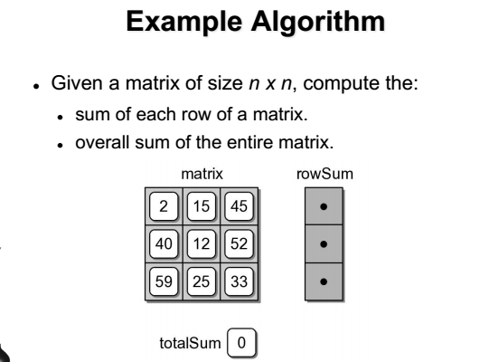

Slide 58
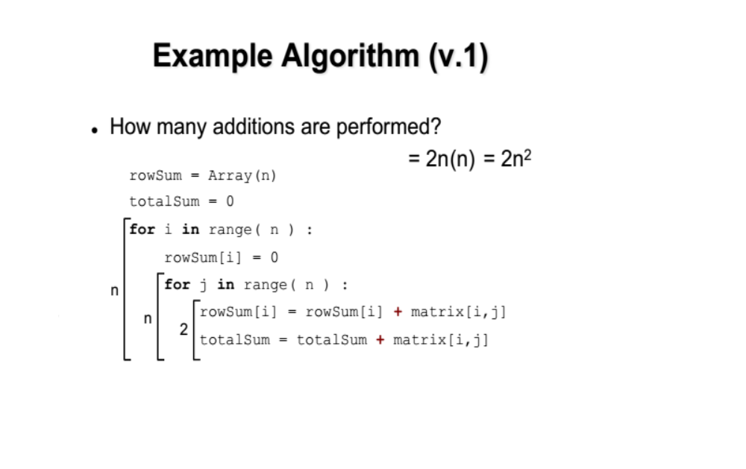

Slide 59
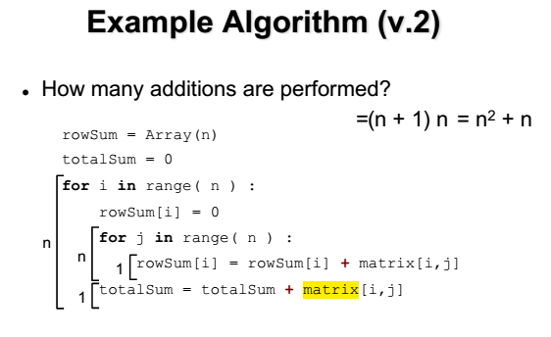

Slide 60
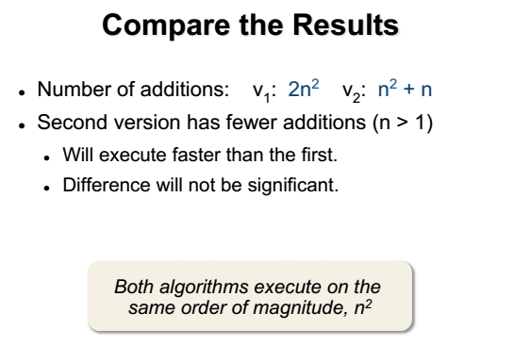

Slide 61
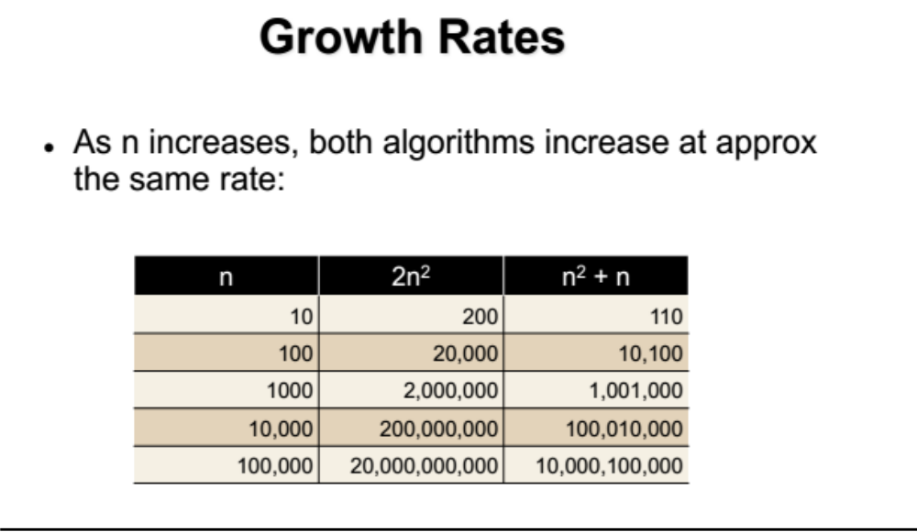

Slide 62
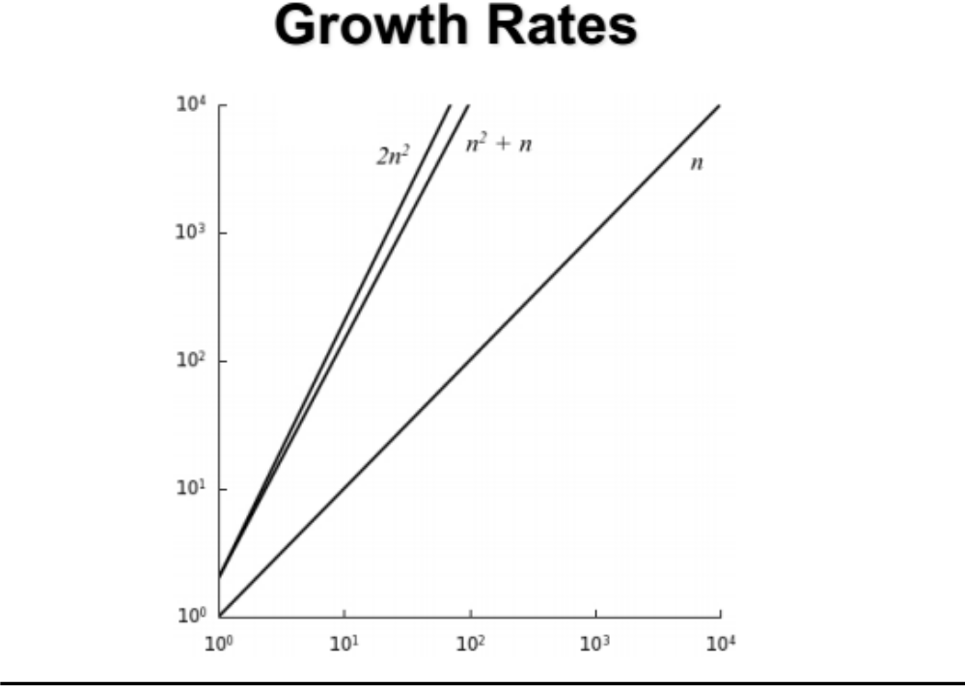

Slide 63
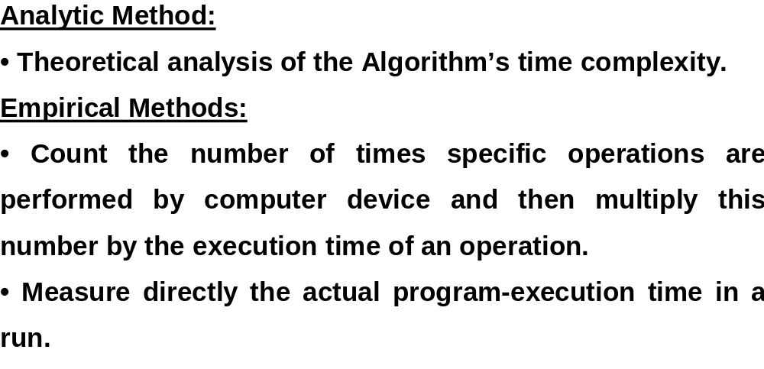
MEASURING PERFORMANCE

Slide 64
Classification of Data Structure Types
Data Structure can be classified into two branches:-
Main Data Structure (ex. Arrays, Record, File, Set)
Advanced Data Structure (ex. Stack, Queue, Double ended Queue, Tree, graph)

Slide 65
Data type
consists of two parts, a set of data and the operations that can be performed on the data, i. e.
1. A domain of allowed values, and
2. A set of operations on those values.

Slide 66
Abstract Data Types
An Abstract Data Type (ADT) is a well-specified collection of data and a group of operations that can be performed upon the data.
The ADT’s specification describes what data can be stored (the characteristics of the ADT), and how it can be used (the operations), but not how it is implemented or represented in the program.

Slide 67
ADT
ADT is a data type whose properties (domain and operations) are specified independently of any particular implementation

Slide 68
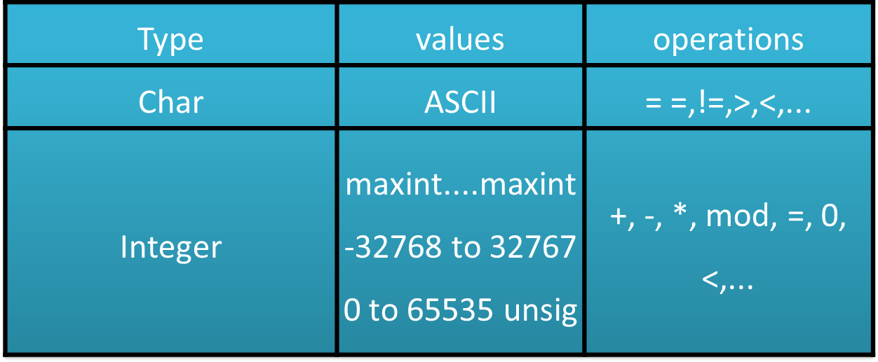
Domains & operations

Slide 69
Domains & operations
Objects such as lists, sets, and queues, and their operations, can be viewed as ADT, just as integers, real, and Booleans are data types
Example: set ADT has operations as union, intersection, size, and complement

Slide 70
An abstract data type (ADT) defines
a state of an object and
operations that act on the object, possibly changing the state.
Similar to a Java class.

Slide 71
The ADTs to be studied (and some sample applications) are:
Stack
  evaluate arithmetic expressions
Queue
  simulate complex systems, such as traffic
General list
  AI systems, including the LISP language
Tree
  simple and fast sorting
Table
  database applications

